Slide 1
The use of Eh-pH diagrams in groundwater geochemistry
Contaminant Transport (GTX 719)
Muravha Sedzani Elia (28234422)

Slide 2
Contents
1. What is an Eh-pH diagram?
2. How do we construct an Eh-pH diagram?
3. Their applications in geochemistry
4. Case study
5. Conclusion
6. References

Slide 3
1. What is an Eh-pH diagram?
Is a diagram that illustrates the equilibrium stability occurrence of minerals and dissolved species as a function of Eh and pH.
(Poehls and Smith 2009).

Slide 4
1. What is an Eh-pH diagram?
Redox potential (Eh) is the energy gained through the transfer of one mole of electron from an oxidant to hydrogen.
The pH is a negative log base of 10 molar activity of H⁺ in aqueous solution
(Poehls and Smith 2009).
(Henke 2009).

Slide 5
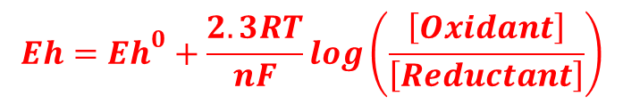
1. What is an Eh-pH diagram?
Eh-pH diagrams are calculated using Nernst equation.
They depend on the temperature and pressure of the reaction.
They can be constructed in 3D as a function of Eh, pH and partial pressure.
$$Eh={Eh}^{0}+\frac{2.3RT}{nF}\log\left(\frac{\left[Oxidant\right]}{\left[Reductant\right]}\right)$$
(Poehls and Smith 2009).
(Henke 2009).

Slide 6
2. How do we construct an Eh-pH diagram?
The stability of water is given as a function of hydrogen and oxygen partial pressures.
Determination of stability limit of water at 25⁰C and 1 atm, using redox half reactions.
(Garrels and Christ 1965).

Slide 7
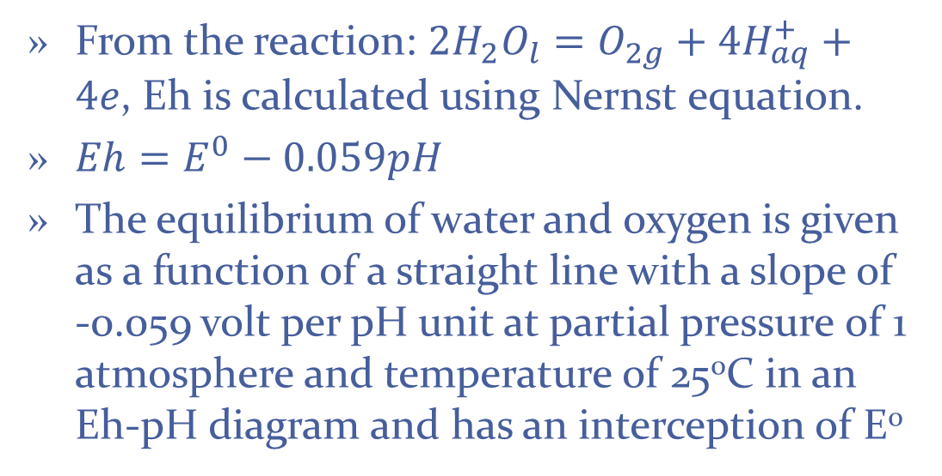
2. Continues…
From the reaction: ${2H}_{2}O_{l}=O_{2g}+{4H}_{aq}^{+}+4e$, Eh is calculated using Nernst equation.
$Eh=E^{0}−0.059pH$
The equilibrium of water and oxygen is given as a function of a straight line with a slope of -0.059 volt per pH unit at partial pressure of 1 atmosphere and temperature of 25⁰C in an Eh-pH diagram and has an interception of E⁰
(Garrels and Christ 1965).

Slide 8
2. Continues…
Figure 1 Stability limits of water as a function of Eh-pH at 25⁰C and 1 atm.
The straight diagonal lines represent the partial pressures of oxygen and hydrogen at intermediate oxidation potential.
(Garrels and Christ 1965).

Slide 9
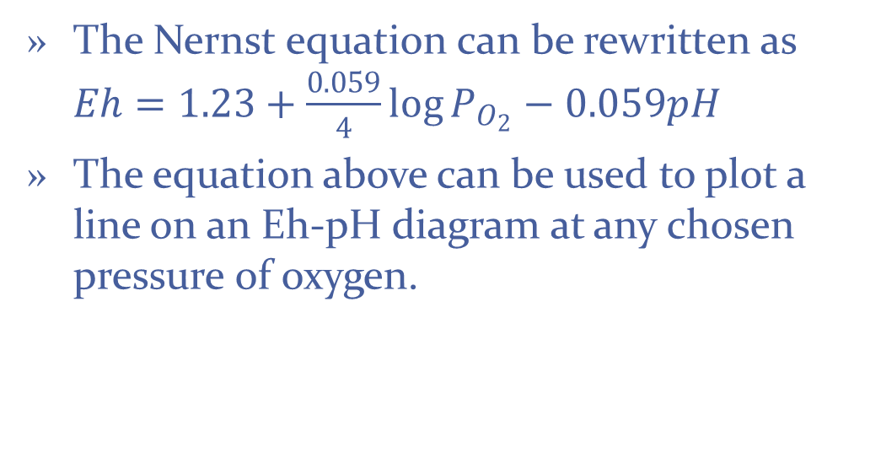
2. Continues…
The Nernst equation can be rewritten as $Eh=1.23+\frac{0.059}{4}\log{P_{O_{2}}−0.059pH}$
The equation above can be used to plot a line on an Eh-pH diagram at any chosen pressure of oxygen.
(Garrels and Christ 1965).

Slide 10
3. Their applications in geochemistry
The common use of Eh-pH diagrams in groundwater geochemistry is to illustrate the stability fields of solids and dissolved species in the solution depending on the redox potential and pH.
(Brookins 1988).

Slide 11
3. Continues…
They are also applied in explanation of mineral paragenesis, in predicting species in a solution, in alteration products of ores and in hydrothermal systems.
They can be used to illustrate equilibrium relationship between dissolved and precipitated species.
(Brookins 1988).
(Hu et al. 2009).

Slide 12
4. Case study
The aim of the case study is to see if there are any significant differences between the Eh-pH diagrams constructed by Brookins (1988) and the new diagrams for study of specific problems in marine geochemistry, and if there are differences; their geochemical implications will be assessed.
(Glasby and Schulz 1999).

Slide 13
4. Case study
The case study was performed at the deep-seawater of Angola Basin.
PHREEQE was used to construct diagrams.
Calculations we done at 2⁰C and 1 bar.
The diagrams were split into two phases.
Only speciation of Mn, Fe, Co, Cu, Ni and As were used for the case study.
(Glasby and Schulz 1999).

Slide 14
4. Case study
Figure 2 The Eh-pH diagrams which illustrate aqueous species and solid phases of Mn calculated for the Angola deep-seawater condition basin
(Glasby and Schulz 1999).

Slide 15
4. Case study
Brookins (1988) stated that; Mn²⁺ is a principal aqueous species of Mn in the seawater.
Case study results showed that various MnO₂ and MnOOH solid phases appeared to be stable, which contradicts with Brookins (1988) findings where the main solid phases were MnO₂, MnO and Mn₃O₄.δMnO_{2.}
(Glasby and Schulz 1999).

Slide 16
4. Case study
Figure 3 The Eh-pH diagrams which illustrate aqueous species and solid phases of Fe calculated for the Angola deep-seawater condition basin
(Glasby and Schulz 1999).

Slide 17
4. Case study
The observed speciation of iron in the seawater were Fe(OH)₃⁰, Fe(OH)₂⁺ and Fe²⁺ with an exception of FeCl⁺ .
The stable solid phases observed were goethite, maghemite and magnetite under deep-sea conditions with pyrite stable under reducing conditions, but siderite appeared to be undersaturated.
(Glasby and Schulz 1999).

Slide 18
5. Conclusion
An Eh-pH diagram is a diagram that illustrates the equilibrium occurrence of minerals and dissolved species as a function of Eh and pH.
The major application of Eh-pH diagrams in groundwater geochemistry is to illustrate the stability fields of solids and dissolved species in the solution depending on the redox potential and pH.

Slide 19
5. Conclusion
Drawn Eh-pH diagrams from the case study determined different speciation of trace elements in the Angola deep-seawater basin and provided the insight understanding in the marine geochemistry.

Slide 20
6. References
Bruland, K. W. (1983) Trace metals in sea-water. In Chemical Oceanography (eds.J.P.RileyandR. Chester), Vol. 8, pp. 157–220. Academic Press, London.
Collins, A.G. (1975). Geochemistry of oilfield waters. Elsevier scientific publishing company, Amsterdam.
Cosovic, B., Degobbis, D., Bilinski, H., and Branica, M. (1982) Inorganic cobalt species in seawater. Geochim. Cosmochim. Acta 46 , 151–158.
Crittenden, J.C., Trussell, R.R., Hand, D.W., Howe, K.J. and Tchobanoglous, G. (2005). Water treatment: Principles and design. Second edition. John Wiley and Sons, Inc, Hoboken, New Jersey.
Garrels, R.M. and Christ, C.L. (1965). Solutions, Minerals and Equilibria. Harper and Row, New York and John Weatherhill, Inc, Tokyo.
Ghosh, A. and Ray, S.H. (1991). Principles Of Extractive Metallurgy. Second Edition. New Age International (P) Ltd. New Delhi.
Glasby, G.P. and Schulz, H.D. (1999). Eh, pH Diagrams for Mn, Fe, Co, Ni, Cu and As under Seawater Conditions: Application of Two New Types of Eh, pH Diagrams to study of Specific problems in Marine Geochemistry. Kluwer Academic, Netherland. Vol.5: 227-248.

