Slide 1
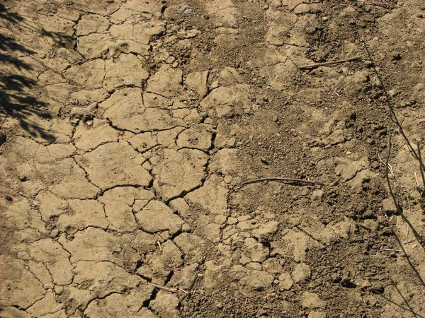
Foundation on expansive soils
Sedzani Elia Muravha
12 January 2012

Slide 2
Contents
Introduction…………………………………………………………...
Characteristics of expansive soils…………………………………..
Engineering properties……………………………………………….
Foundation types.....................................................................................
Engineering problems…………………………………………………
Engineering solutions…………………………………………………
Conclusion………………………………………………………………
References………………………………………………………………..

Slide 3
Introduction
Foundation is the lowest load-bearing part of engineering infrastructures, typically below ground level.
Foundations are affected by engineering properties and characteristic of the soil.
Engineering problems and type of foundation support are vital in construction of foundation.

Slide 4
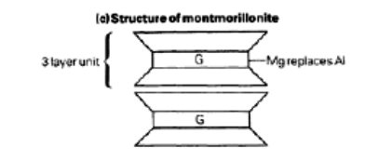
Characteristics of expansive soils
The expansive properties of soils depend on the grain size, mineralogy and water content.
The 2:1 sheet smectite group include expansive monmorillonite clay.
Montmorillonite swell and shrink at different moisture content.

Slide 5
Engineering properties
1. The strength of the foundation
2. Permeability
3. Excavatability
4. Density
5. Plasticity index

Slide 6
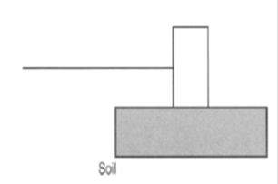
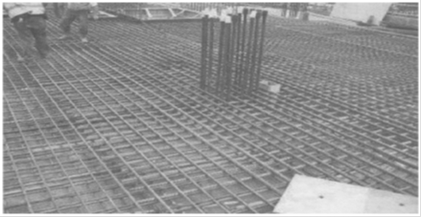
Foundation types
There are different types of foundation in geotechnical engineering.
1. Shallow foundations
2. Mat foundations

Slide 7
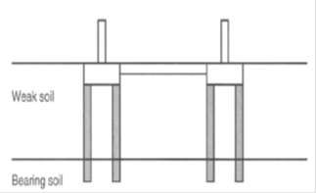
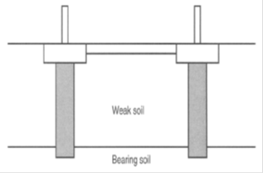
Foundation types
3. Pile foundations
4. Caissons

Slide 8
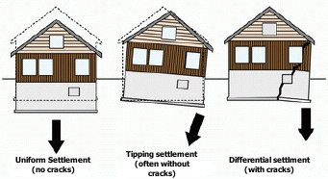
Engineering problems
Swelling and shrinking of soil.
Available: www.denverfoundationrepair.com/images/expansive-soils2.jpg

Slide 9
Engineering solutions
1. Post-wet and pave the area with bricks or blocks laid on the plastic membrane.
2. Total removal of expansive soils.
3. Under pinning with piles.
4. Reinforcement of with tie-bars.
5. Caissons foundation.

Slide 10
Conclusion
Foundation on expansive soils is affected by the behaviour of soil under different moisture content.
The swelling tendency of expansive soils on foundation can be quantified by the swell potential and swelling pressure parameters.
The major engineering problem of expansive soils on foundation is shrink-swelling characteristics of the soil.
Foundation types that can be utilised on expansive soils are pile, raft, shallow and caissons foundation.

Slide 11
References
1. Al-Rawas, A.A. and Goosen, F.A.M. (2006). Expansive Soils: Recent advances in characterization and treatment. Taylor & Francis Group. London. -540pp
2. Brink, A.B.A., (1983). Engineering geology of Southern Africa. Building Publications. Silverton. (Vol.3), pp. 177-209.
3. Horpibulsuk, S., Suksiripattanapong, C., Niramitkornburee, A., Chinkulkijniwat, A. and Tangsutthinon, T. (2011). Performance of an earth wall stabilized with bearing reinforcements. Geotextiles and Geomembranes. 29:514-524
4. McLean, A.C. and Gribble, C.D. (2005). Geology for civil engineers. 2nd edition. E & FN Spon. Taylor & Francis e-Library. -348pp
5. Rajapakse, R. (2008).Selection of Foundation Type. Geotechnical Engineering Calculations and Rules of Thumb. 171-175
6. Shi, B., Jiang, H., Liu, Z. and Fang, H.Y. (2002). Engineering geological characteristics of expansive soils in China. Engineering Geology. 67: 63–71

